Slide 1
Logarithms

Slide 2
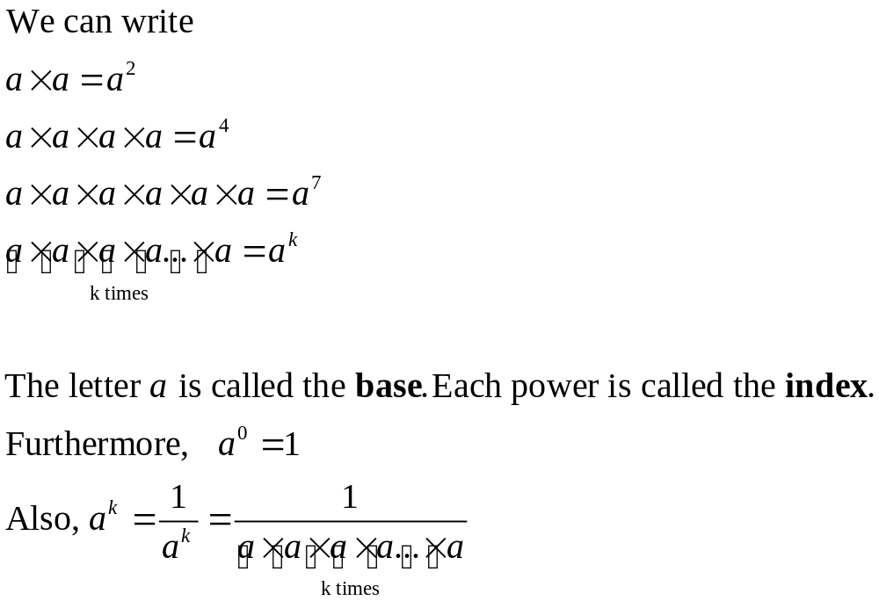
Indices

Slide 3
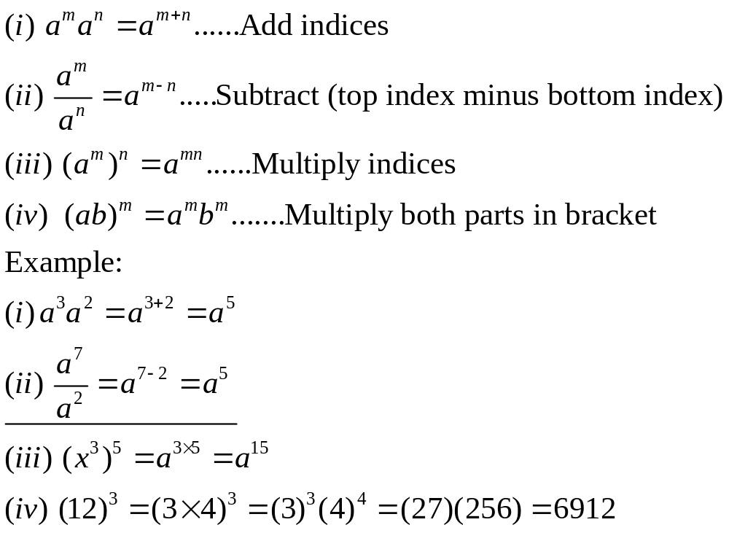
Laws of Indices

Slide 4
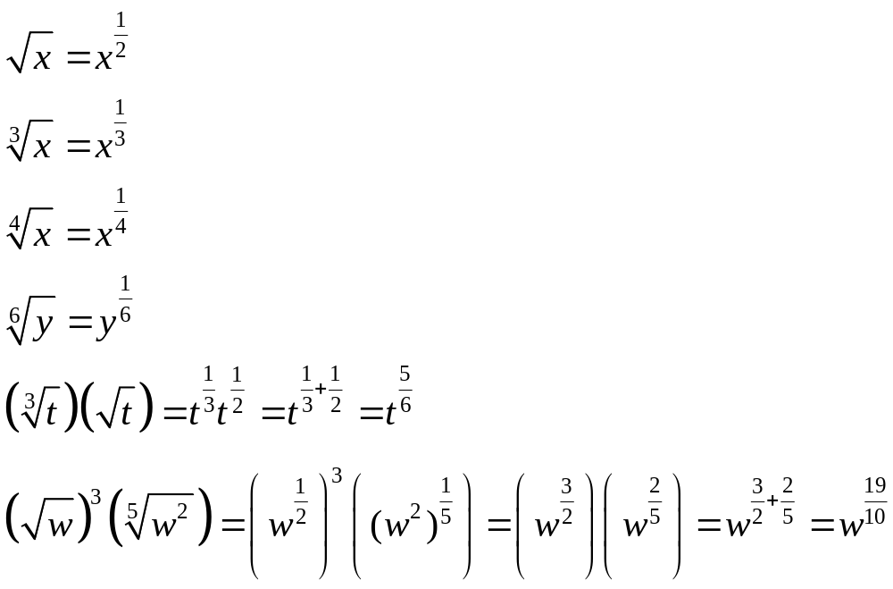
Indices & Roots

Slide 5
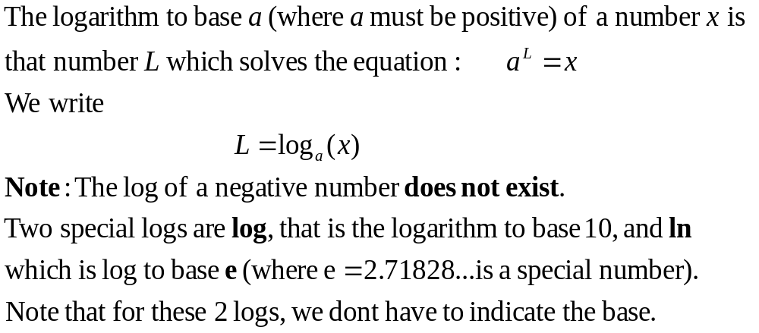
Definition of a logarithm

Slide 6
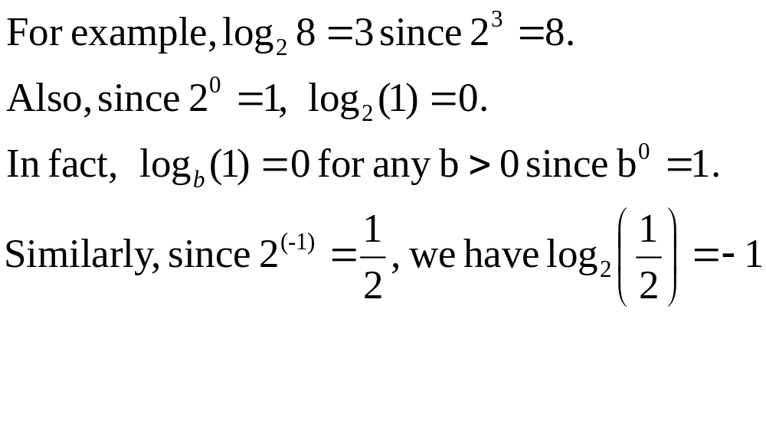

Slide 7
The logarithm of a number to a given base is the power (or exponent) to which the base must be raised in order to produce the number.
e.g.
The base-10 log of 1000 is 3, because 3 is the number of 10’s that must be multiplied together to get 1000.
The base-2 log of 32 is 5, because 5 is how many 2’s must be multiplied together to get 32.

Slide 8
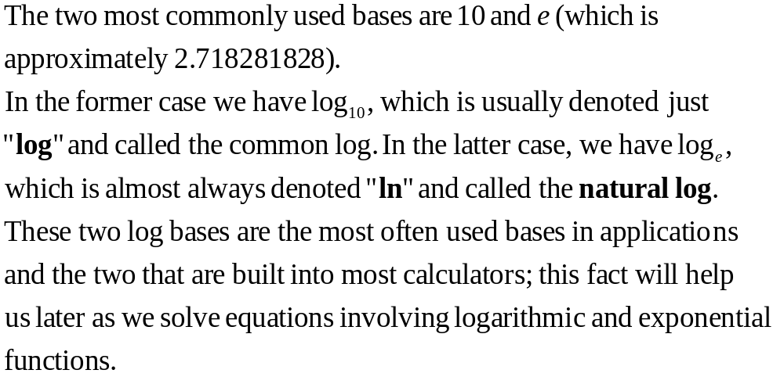

Slide 9
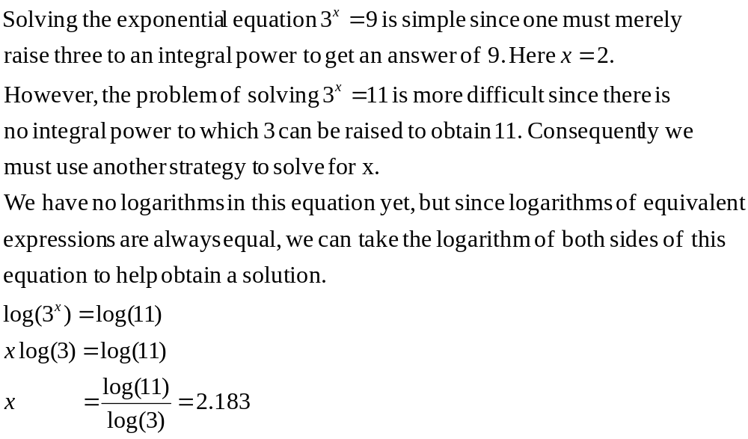
Solving simple Exponential and Log Equations

Slide 10
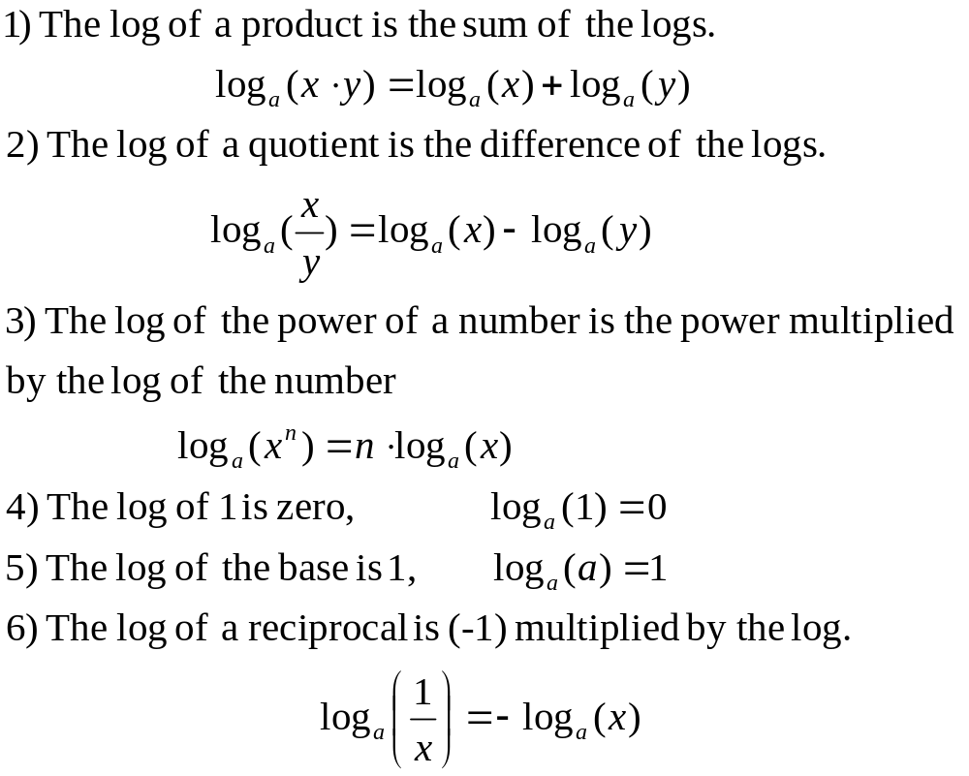
Properties of Logs

Slide 11
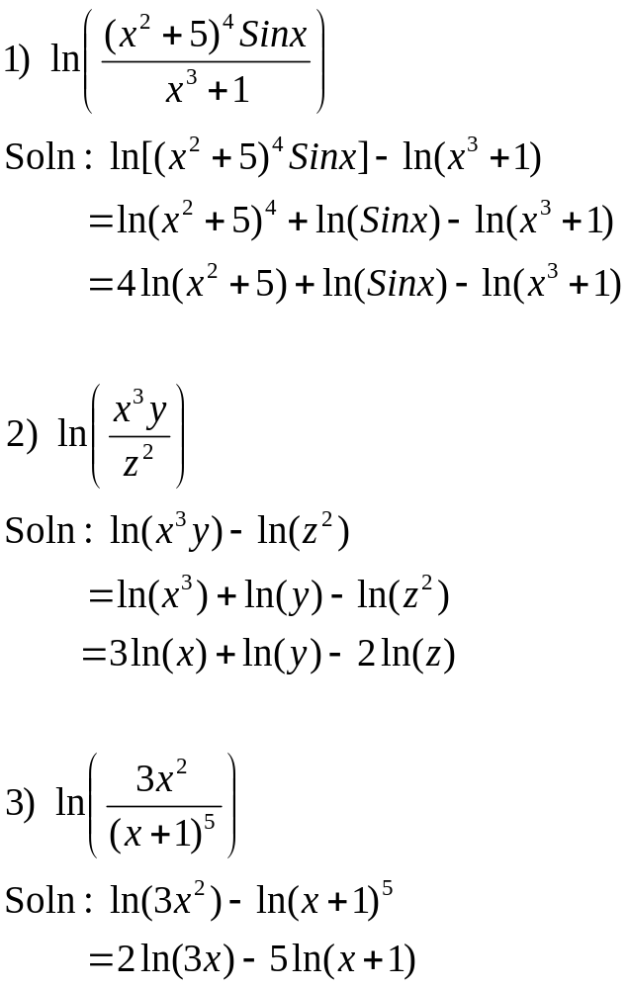

Slide 12
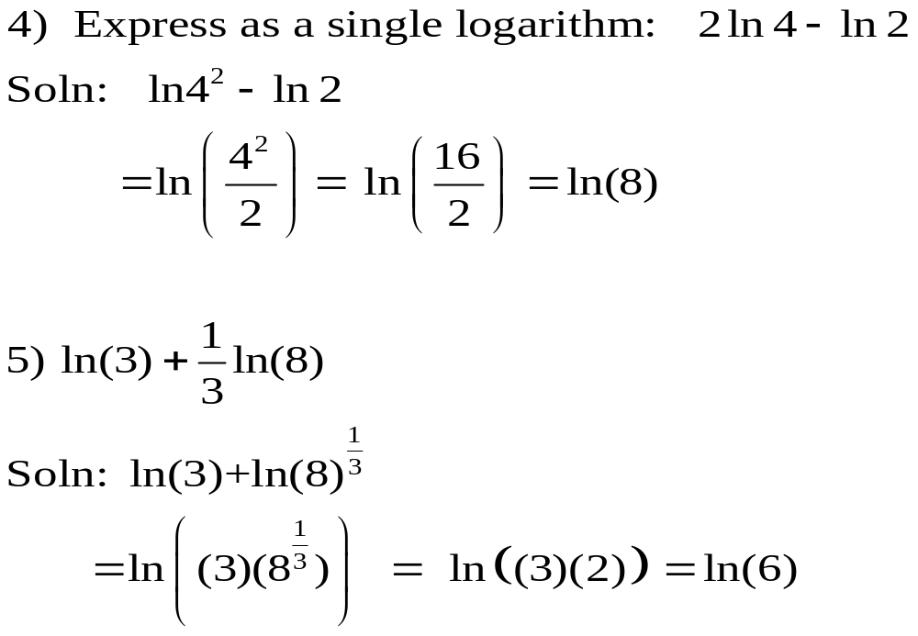

Slide 13
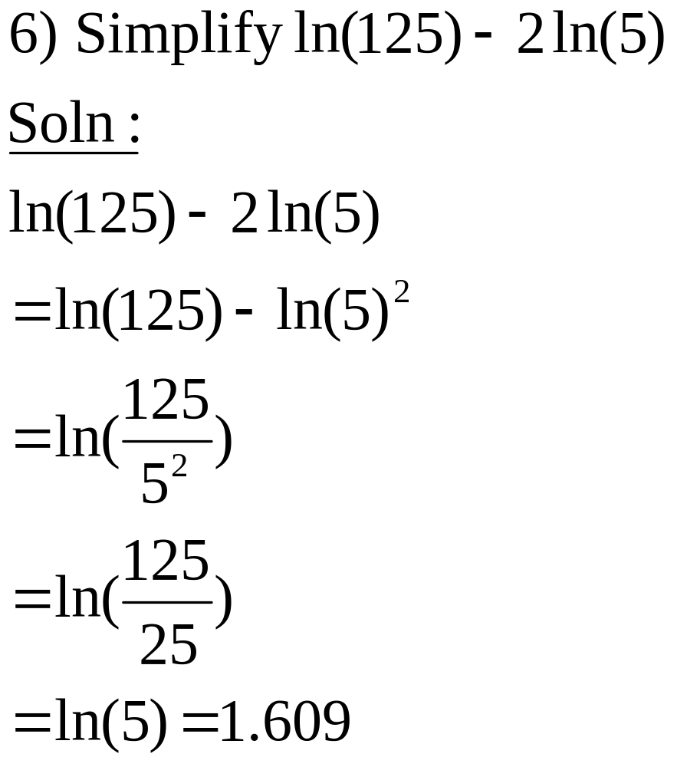

Slide 14
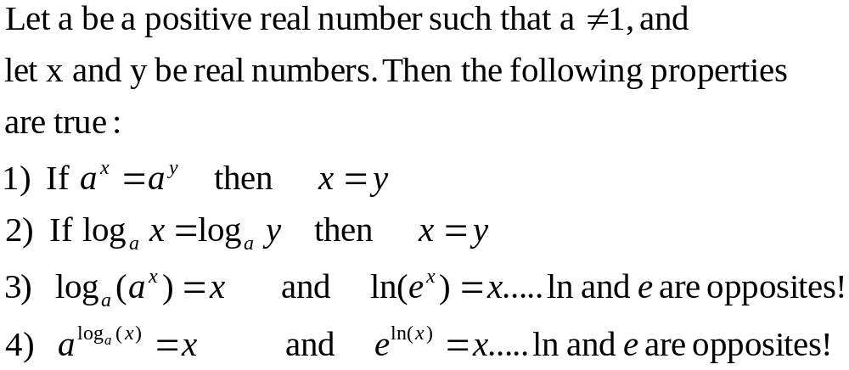
Solving Exponential and Logarithmic Equations

Slide 15
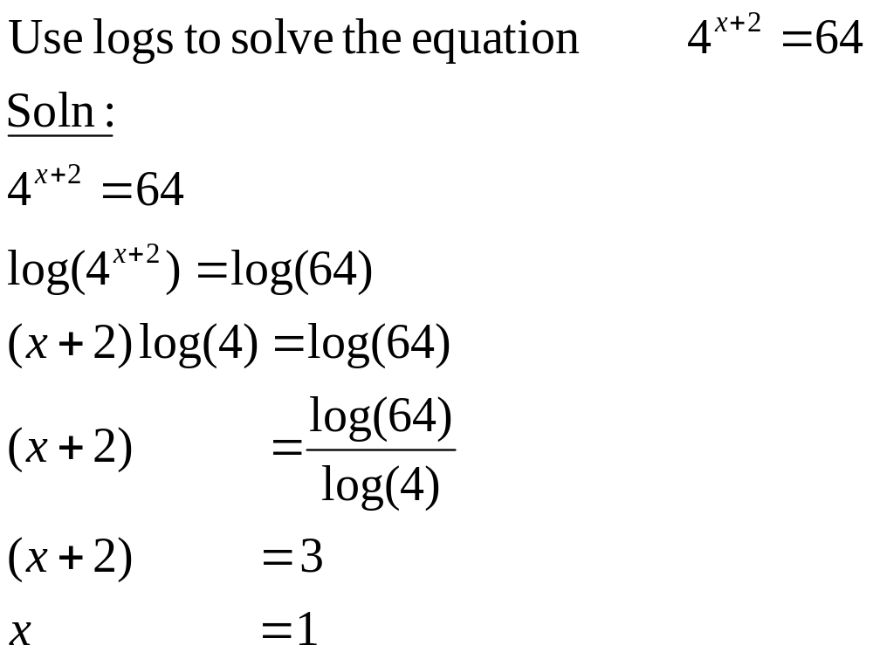

Slide 16
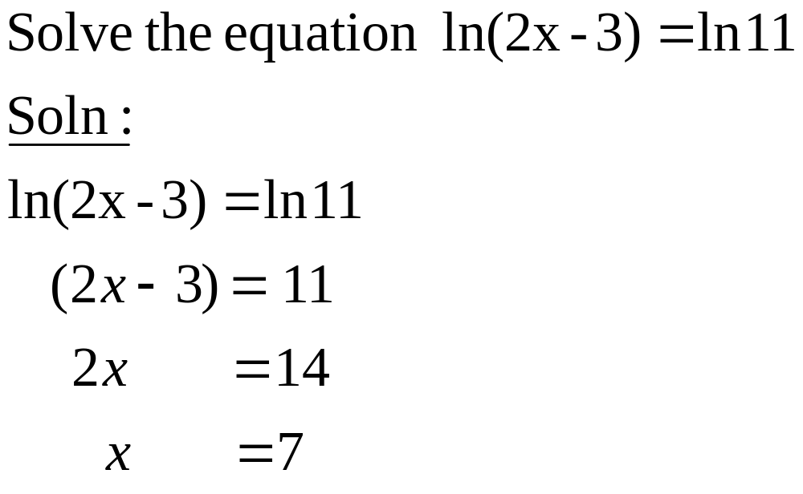

Slide 17
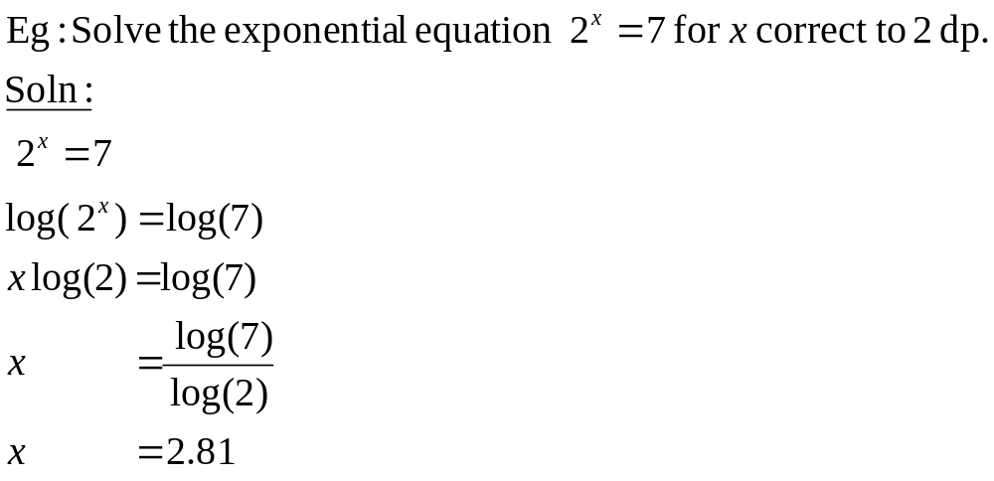
Solving exponential equations
  To solve an exponential equation, first isolate the exponential expression (the power). Then take the log of both sides of the equation and solve for the variable.

Slide 18
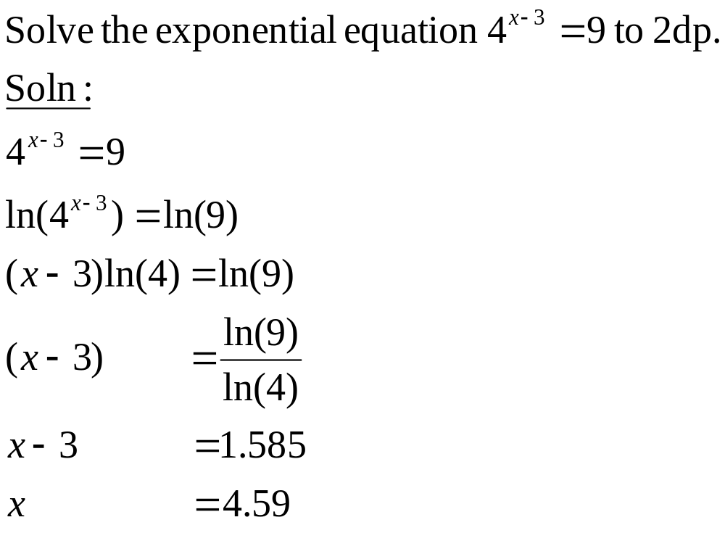

Slide 19
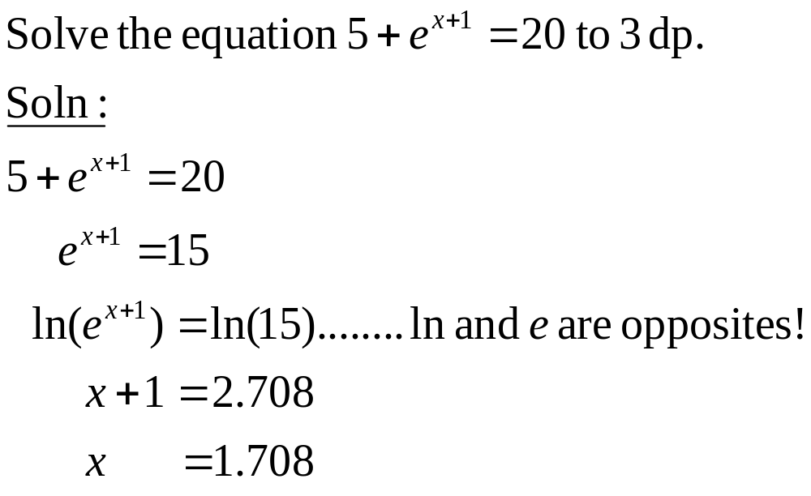

Slide 20
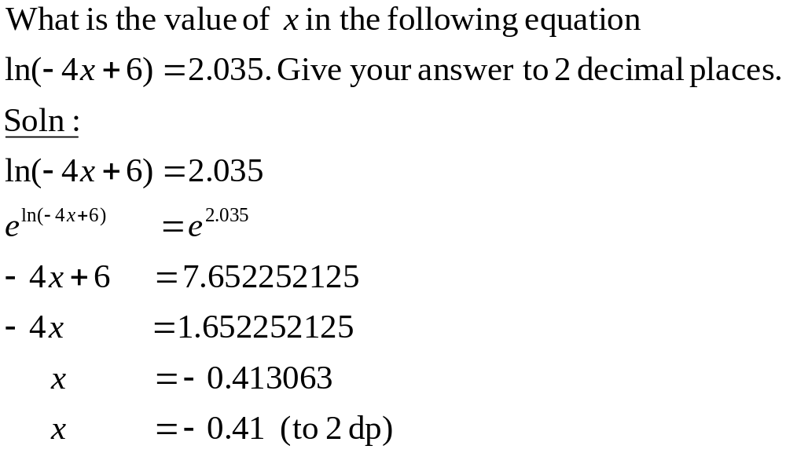

Slide 21
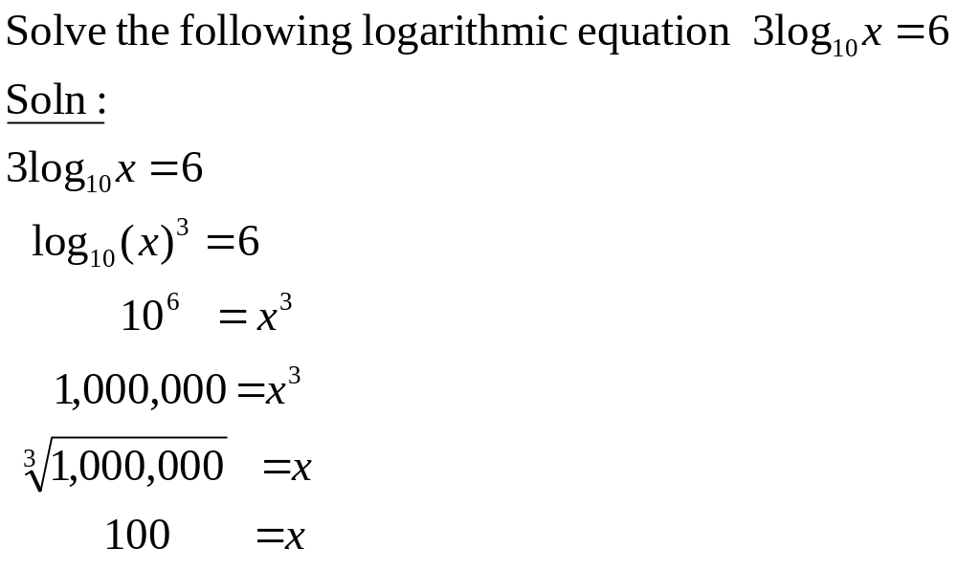

Slide 22
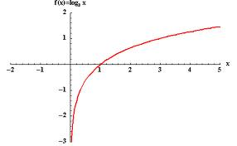

Graph of Log function

Slide 23
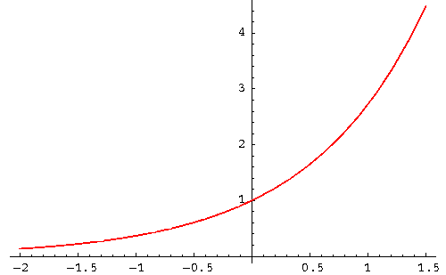

Graph of Exponential function

